Slide 1
CANSKATE PARENT MEETING
Important highlights
CANSKATE INFORMATION & REPORT CARDS – Where to find it
PRIVATE LESSONS
HEALTHY KIDS! ACITVE KIDS!
STORM DAYS
EVENTS

Slide 2
Welcome to Canskate
Are you new to canskate? Welcome to SPSC
1
For any not aware
3
Chanda Bissett is our Club President
And Laurie Godfrey is the Club Administrator
You can reach any of our board or coaches through our office email office@sherwoodparkdaleskatingclub.com or go to our Contact us page for individual contacts or direct link to our club address
4
Jessica Godfrey is your Canskate coordinator
If you are returning… Welcome Back
2

Slide 3


Where to find things

Slide 4
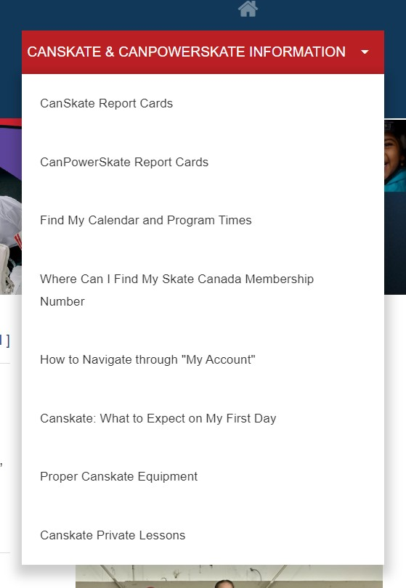
How to find things
Drop down menu

Slide 5
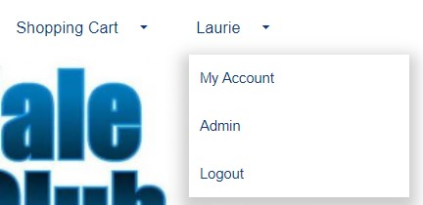
Your Account
To find a lot of information from our “How to Info”, you need to be logged into your account
  Once logged in go to the upper right corner where you will see your name
  Click on my account from the drop down when you hover over your name
  Once in “my account” you will have a menu bar specifically for you.
THE CALENDAR tab in your account
  will show all your registered skating days, events etc. A non-skating day may show a tournament instead of your regular skating time. These were pre-scheduled. You were not charged for these days in your registration fee, there are no make-up days.
  This is the best “go-to” as it shows your registered session times. It the event of any changes, it will show here first.
There are other items such as evaluations, achievements, copies of your invoices…explore your account!

Slide 6
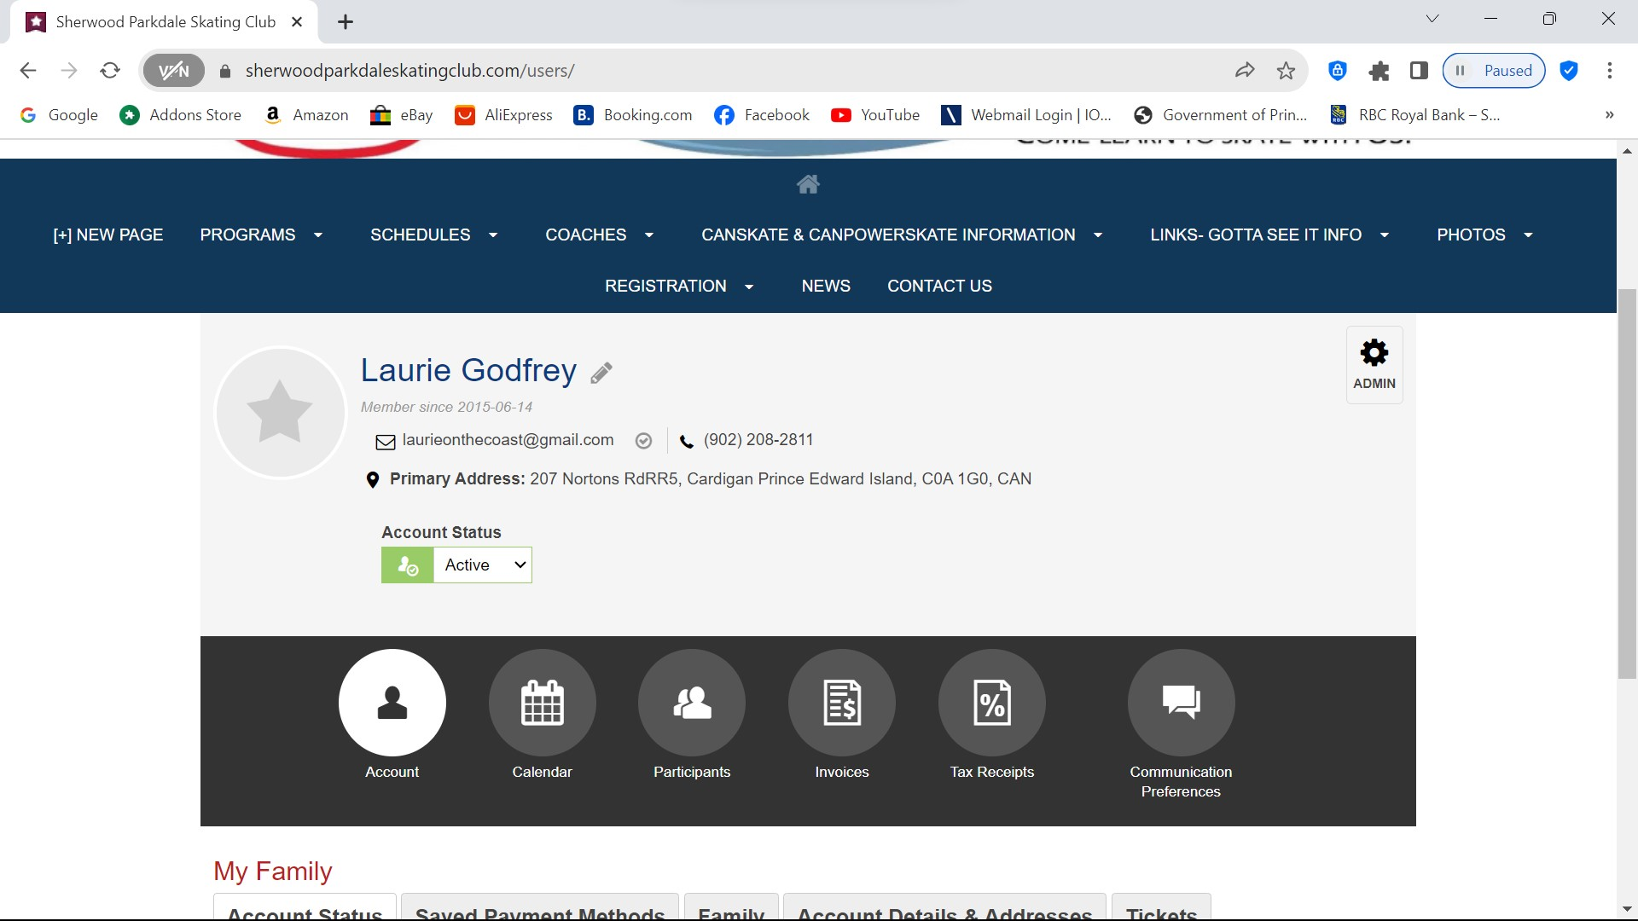

Accessible in your personal account

Slide 7
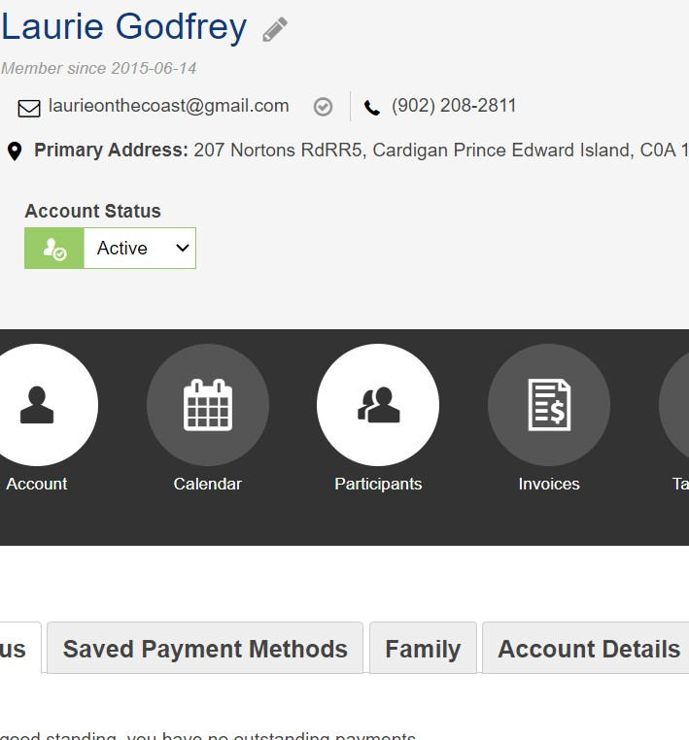
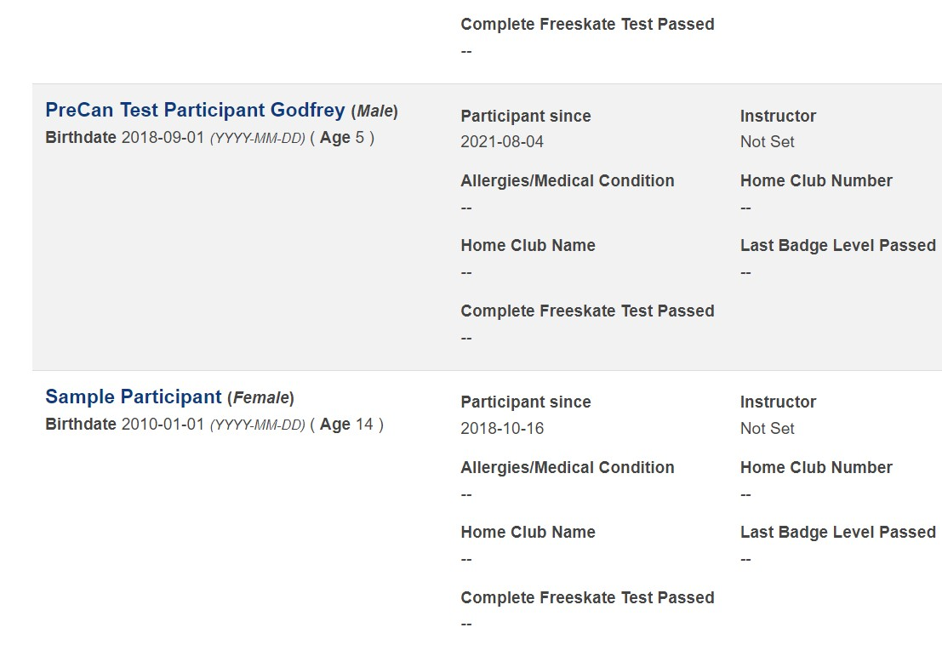
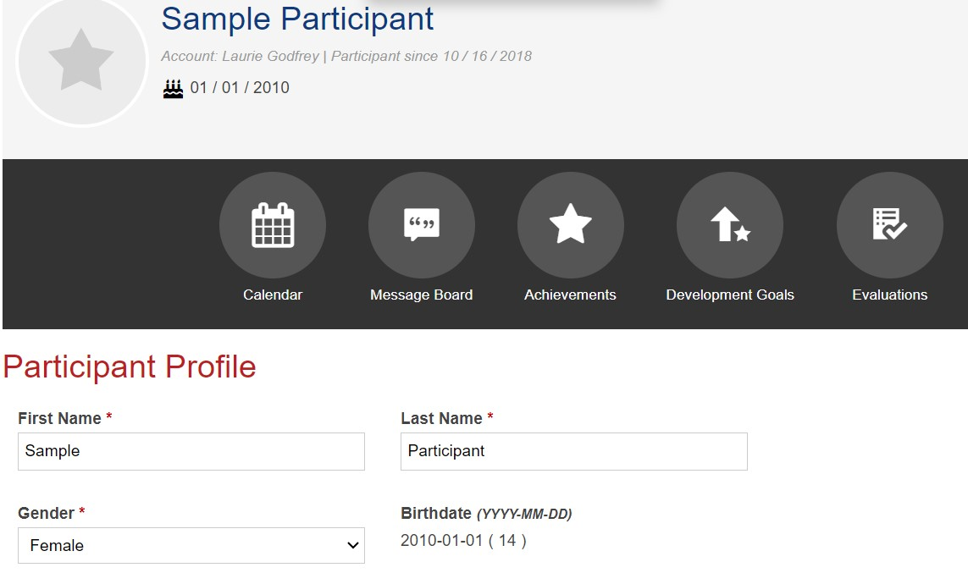


3 – view achievements and evaluations
1 - Click on Participants
2 – Select Participant
FROM WITHIN YOUR ACCOUNT – SEE YOUR PARTICIPANTS PROFILE

Slide 8
Notices
STORM WATCHES AND CLOSURES – in the event of storms or unforeseen closures, we will post on our website as well as send you an email. We normally only close if the facility is closed. Therefor if you see from a community posting that the arena is closed, then so are we. There is the off-chance if our administrator does not have power, they will not be able to email you. Please don’t call the arena as they are not part of our operation for detailed info.
Along with sending email we also have a bulletin board in the lobby where we will post updated information, special events and more. Check it out once-in-a-while for new information.

Slide 9
On Ice Specifics
Your skaters name tag will have a colour indicating their group
  This colour does NOT reflect what stage of canskate achievement they have
  The groupings on the ice are to maintain coach ratio and put children together that are either at the same level or working on similar skills.
  Skaters may get moved from time-to-time to another group for best practice
  If they skate more than one day a week, they may have a different colour group on each day dependant on the balance of skaters on the ice for that day.
  No matter which group a skater is in, they will ALWAYS work at their personal level.

Slide 10
Coaching Staff
There will be up to four professional NCCP certified coaches on the ice.
  They usually will be wearing a red coat, with “ coach” on the back
Assisting them are our Program Assistants.
  Program Assistants are from our Starskate Program. They are volunteers who have undergone program assistant training.
  They will be wearing blue jackets and red hats. They are not required to wear helmets based on their skating level and insurance coverage. So, if you see a young person out there without a helmet, they are a program assistant. All CANSKATERS MUST WEAR A CSA APPROVED HOCKEY STYLE HELMET.

Slide 11
PRIVATE LESSONS
Option for skaters registered in a group program based on availability.
Canskate: private lessons may be arranged with the coach of your choosing as available. Lessons from our Group Canskate Coaches would need to take place during another session time. You can be on a non-canskate session for the length of your lesson only. You may also contact non-Canskate Group Coaches to have private lesson time during Canskate Sessions space permitting. Private lessons are based on availability of coaches and all payment arrangements are between you and the coach.

Slide 12
Canskate Events
There are additional events for our Canskaters to participate in.
  December 22nd Ice Gala – Holiday Performance & Food Bank Drive. It is for all level of skaters including those requiring assistance. There is no cost but registration is requested.
  March 26th Canskate Merit Event – This event is part of the long-term development within Skate Canada. It is a time to celebrate and let your skaters shine and show their skills they have been learning. Each skater will be assessed and receive feedback, a certificate and ribbon. It’s fun and a great celebration of their achievements. Registration if required. There is a $5 fee for this event.

Slide 13
Healthy Kids! Active Kids! Fundraiser
Our Main Club Fundraiser
This is not mandatory however we are asking all Canskaters and Powerskaters to consider purchasing at least one item.
We have been hit hard with increased operating expenses from all areas this season ie ice costs, insurance, coaching, supplies etc and we DO NOT want to pass these increases off to you by increasing registration fees. Sports are expensive enough for families and we would rather put food on your tables than increase fees.
New partner “Mike’s Queen Street Meat Market”
If you are keen and you purchase more than 10 items, you will receive a credit on your personal account as well as helping the club overall.
Extra order forms are available. We will also email out a copy for printing or using digitally.

Slide 14
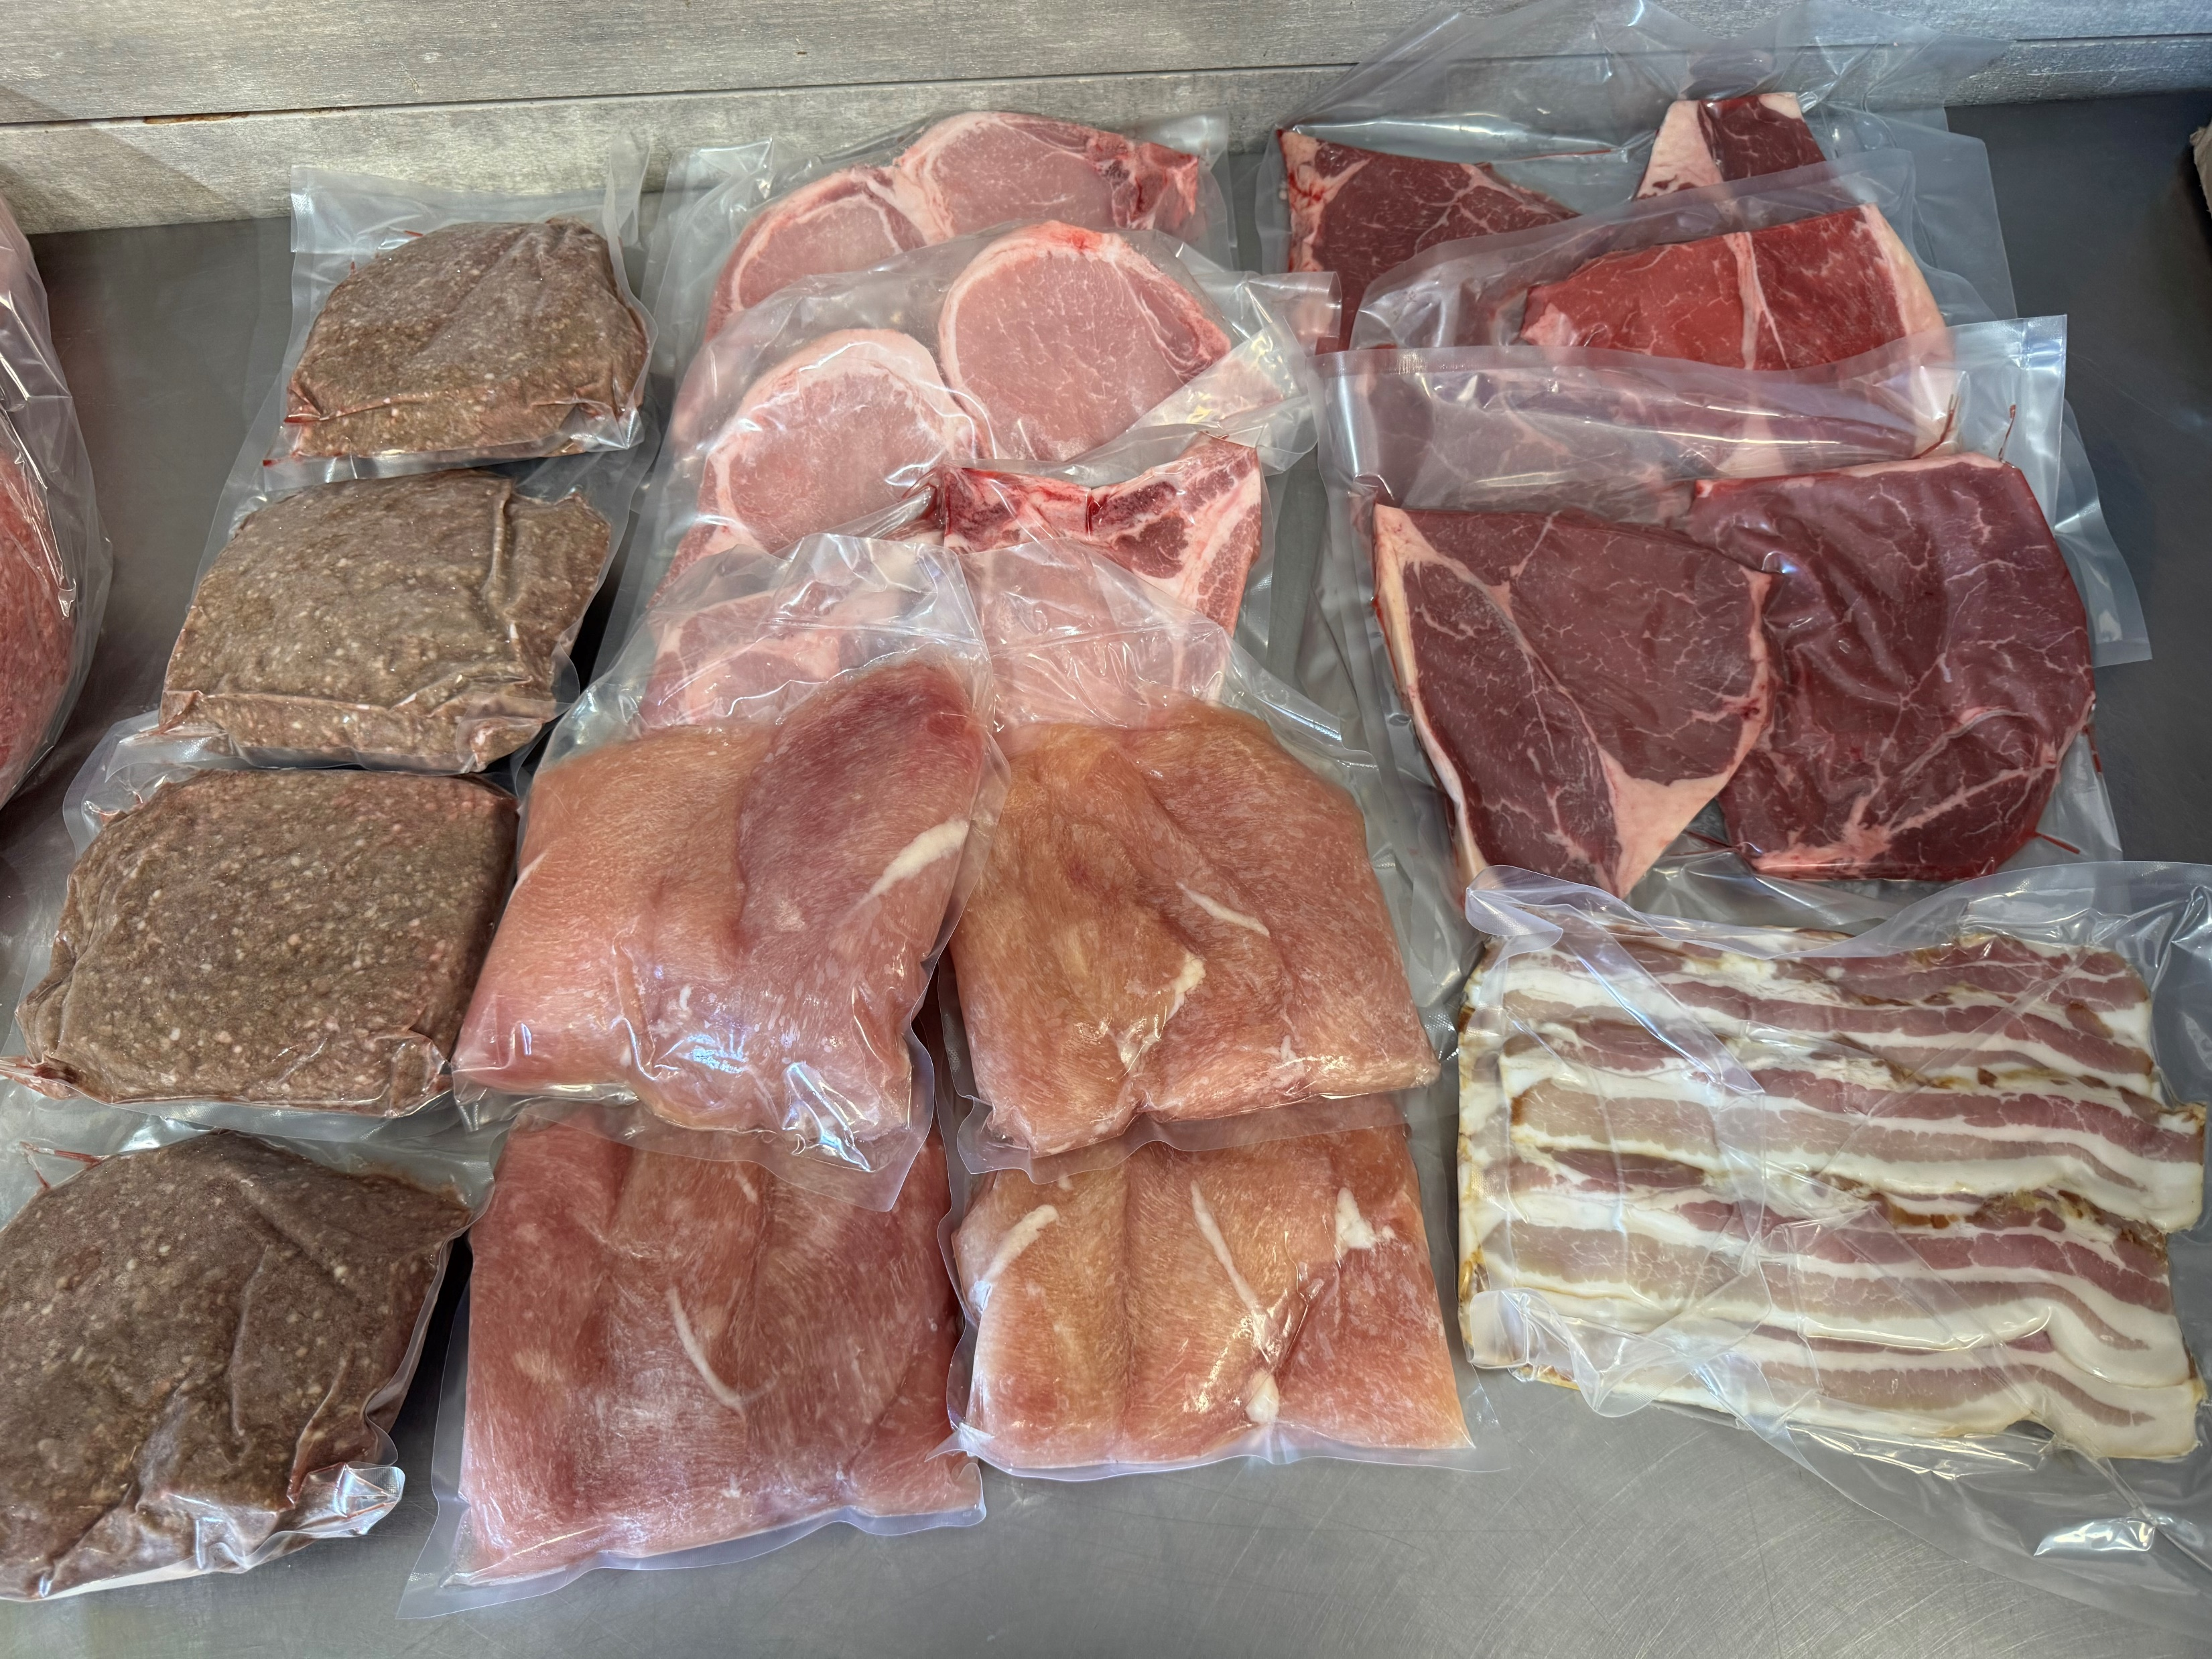
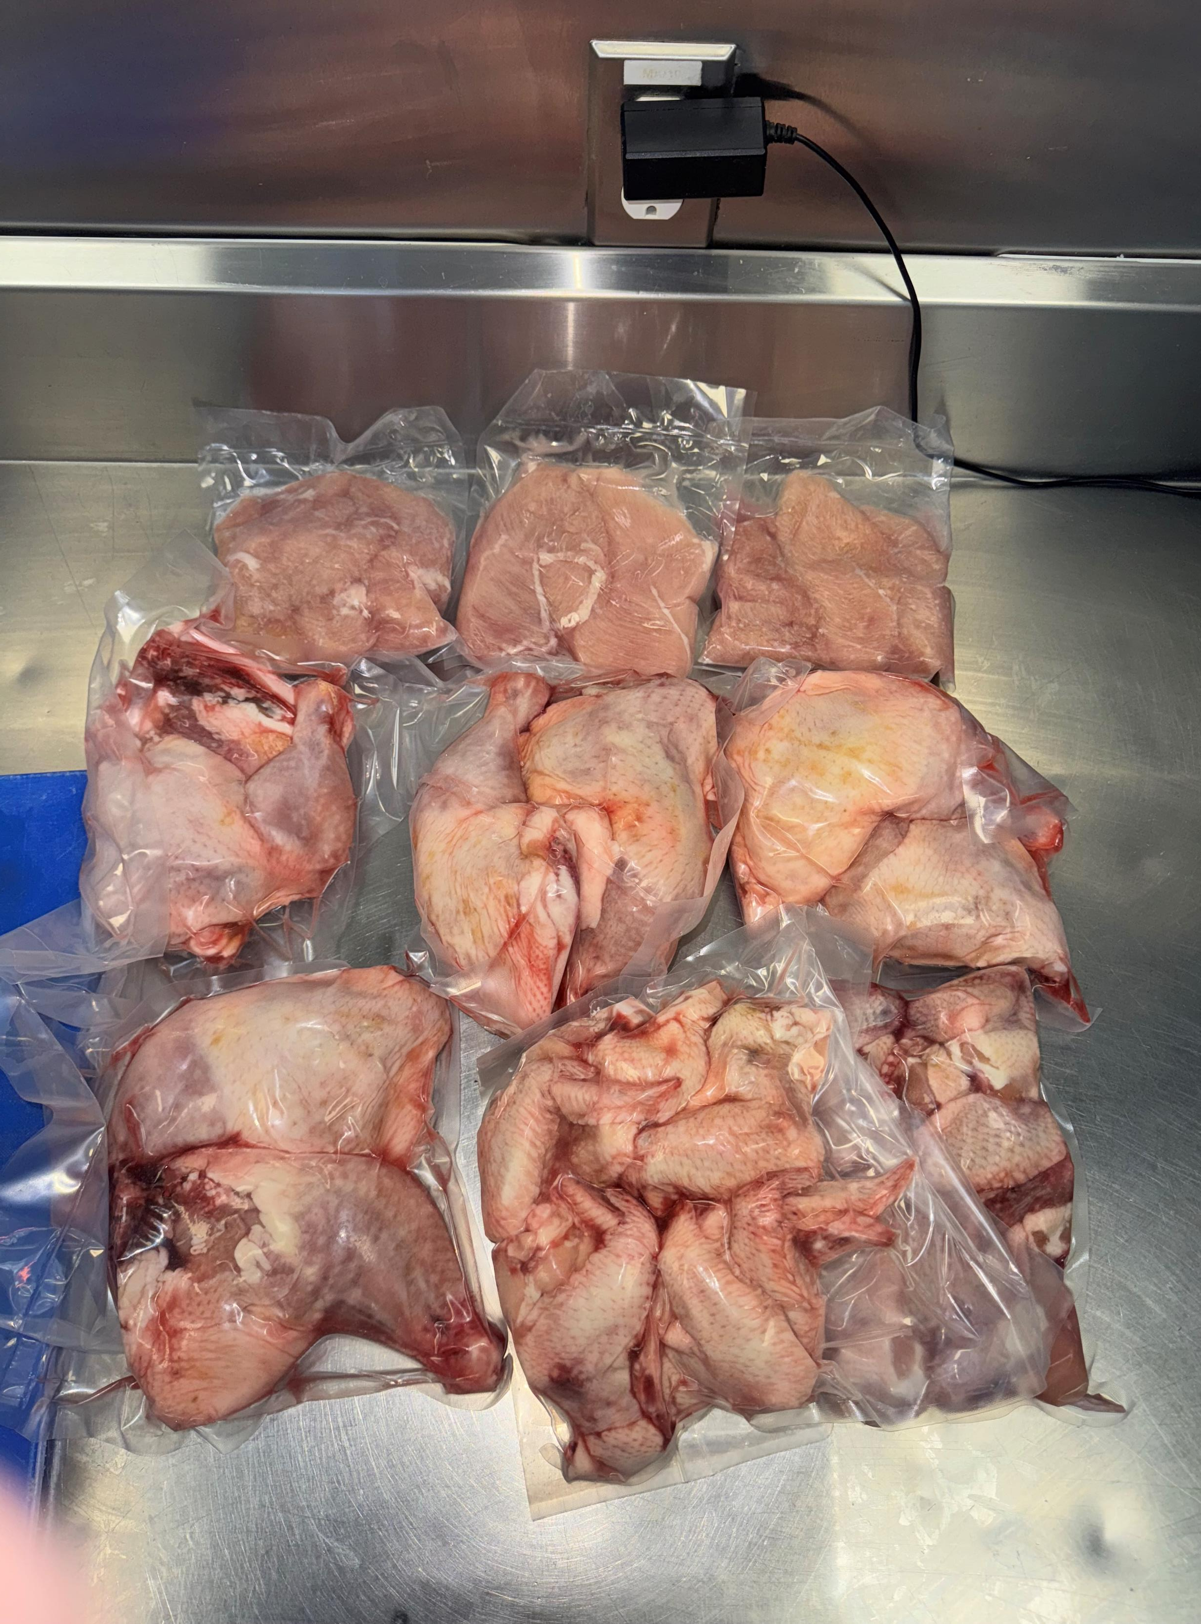

Slide 15

We are always looking for volunteers
This can be during your scheduled skating time only or at special events or if you love our skating community, we always could use someone new on the board.
During your skating time we are looking for those that would be willing to assist with:
  Handing out colouring sheets or other treats
  Assisting coaches, for example: if they are trying to locate a parent
  Monitoring the entrance/exit door so that it does not get congested with parents
  Assist coaches (from the off-ice side of the door) getting skaters onto the ice
Special Events
  Notices will go out for help regarding our Ice Gala and Merit Event.

Slide 16
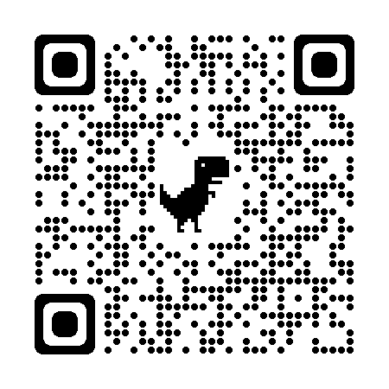
Club Apparel
We have a store available through Allstar Cresting
  There are t-shirts, hoodies, outdoor jackets and more – Get in the spirit with quality merchandise. 10% goes to the club.
Here at the club, we also have mittens/gloves and a limited supply of skate guards for sale
Club competition/practice jackets are orderable through the club. Reach out to us at office@sherwoodparkdaleskatingclub.com if you are looking for an on-ice jacket. You can follow this link to our Allstar Store. This is also posted on our bulletin board.

